Slide 1
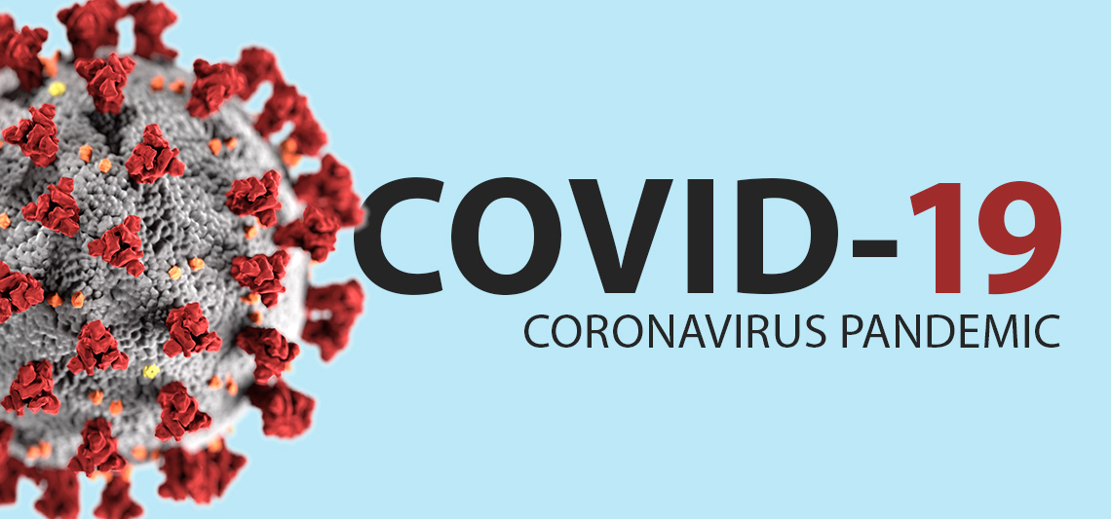
SQL Project on the OWID-COVID Database

Slide 2
6.5 Million DEATHS
619Million CASES
5 Thousand Million vaccinated
COVID-19 is currently ranked as the seventh deadliest disease in the world.
The percentage of registered deaths ranged from 98% in the European region to only 10% in the African region.

Slide 3
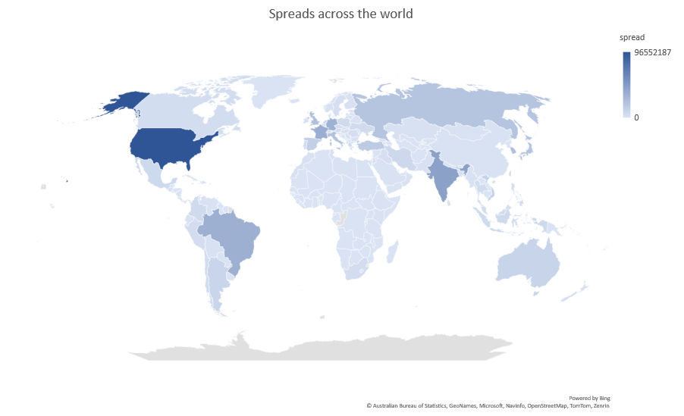
The spread of COVID-19 was high in the United States.
This is likely due to the fact that the US has maintained the data very effectively.

Slide 4
The number of cases peaked in January 2022.
Although the number of cases was high in January 2022, the number of deaths remained low.

Slide 5
COVID-19 deaths decreased after vaccine development.
It is notable that there has been a significant decline in the number of fatalities during the middle of 2022.

Slide 6
European countries experienced a significant number of both cases and Deaths.
In Africa and Oceania, the spreads and deaths were low

Slide 7
Due to the high spread range in the United States, the death rate was also high.
The United States has accurately maintained data on the spread of COVID-19.
Although Brazil had a higher vaccination rate, the death rate was still high.

Slide 8
Different income groups and their spreads.
The low-income group has the low spread
It is highly probable that the reason for this is inadequate data gathering.

Slide 9
Survival rates across the world and in India
The survival rate in the WORLD is 98.9427
The Survivals of the WORLD 613 Million
The total number of COVID-19 survivors in INDIA is 4.4 Million
The survival rate of INDIA is 98.8146
Thanks to its impressive vaccination rate, India was able to achieve a remarkable survival rate.

Slide 10
A high GDP does not guarantee a low spread rate.

Slide 11
A high GDP does not necessarily equate to a low death rate.

Slide 12
thanks

